Slide 1

Basic Details of the Team and Problem Statement
Ministry/Organization Name/Student Innovation:
Ministry Of Mines
PS Code:1338
Problem Statement Title: Unpredictable failure of poly pulleys along cable belt conveyor system for pulley changing
Team Name: Orion DeepL
Team Leader Name: J Ryan Roy
Institute Code (AISHE): U-1229
Institute Name: St Joseph’s University, Bangalore
Theme Name: Transportation and Logistics

Slide 2
Idea/Prototype
This proposed idea is that of a specialized application for predictive maintenance tailored specifically for poly-pulley systems used in mines and heavy industries. The application relies on historical data and real-time sensor inputs to analyze the condition of pulley systems.
The application's key function is to predict when individual pulleys are likely to fail and precisely identify the problematic pulley within the system and its location.
Parameters Analyzed: Various critical parameters are considered for analysis, including:
Belt tension
Temperature & Vibrations
Noise levels
Oil contamination or foreign residue
Environmental conditions (temperature and humidity
Belt cross-section
Elapsed time since the last servicing
Camera Integration: Cameras are used to monitor and detect cracks and foreign residue contamination on the conveyor belt, which can serve as an early warning sign of potential pulley issues
Machine Learning Models: The application employs machine learning models that have been trained on historical data, including both instances of pulley failures and non-failures. These models provide real-time predictions regarding the likelihood(probability) of pulley failure at the time of data recording
Maintenance Alerts: When a predefined threshold is reached or exceeded, the application triggers maintenance alerts. These alerts include location labels, making it easier for maintenance teams to address the issue promptly and efficiently
The app will contain a 2d map of the site, using which the exact position of the pulley will be pin-pointed on the map.

Slide 3

Tech Stack

Slide 4


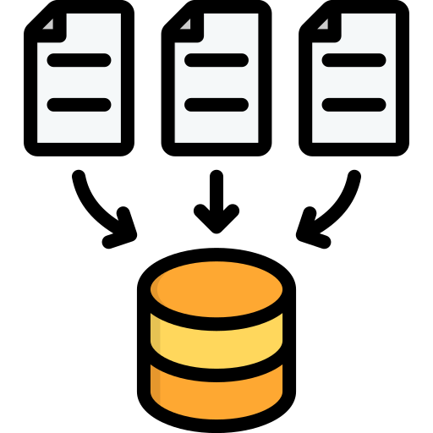





Architecture
Normal condition
Cameras and sensors
Data Gathering
Data Preprocessing
Abnormal condition
ML model
USER INTERFACE
Location via SMS
Alert

Slide 5
Use Cases
Conveyor Reliability
Safety Improvement
Cost Reduction
Remote Monitoring

Slide 6
Dependencies / Show stoppers
Generation of Sensor Data: The final product depends on the deployment and availability of sensors to measure the parameters and generate data for the model.
Historical Data: Machine learning models used for predictive maintenance depend on historical data that includes both instances of pulley failures and normal operation.
Camera Systems: For monitoring cracks and foreign residue contamination CCD cameras, the availability and proper functioning of camera systems are necessary dependencies.
Maintenance Teams: Effective response to maintenance alerts depends on the availability and competence of maintenance teams capable of addressing issues promptly.

Slide 7
Functionality
Data Analysis Parameters:
Pulley Type, Alignment ,Belt Tension, Belt Width, Lagging Type, Temperature, Vibrations, , Oil Contamination, Foreign Residue Contamination, Humidity , Elapsed Time since Last Servicing, Belt Length, Cracks(pulley), No of Grooves: The inclusion of these parameters indicates a thorough understanding of the factors influencing pulley system health. Analyzing these parameters provides a holistic view of the system's condition, enhancing the accuracy of failure predictions.
Camera Integration:
Cracks on the Conveyer Belt and Foreign Residue Contamination : Integrating cameras for predicting cracks on the conveyer belt and abnormal conditions such as foreign residue through visual data can serve as a valuable early warning system, allowing for timely intervention.
Machine Learning Models:
Training on Historical Data: The use of machine learning models trained on historical data, encompassing both failures and non-failures, is a key strength. This approach enables the models to learn patterns and trends, enhancing their ability to predict pulley failures in real-time accurately.
Maintenance Alerts:
SMS Notifications: The inclusion of predefined thresholds for triggering maintenance alerts is a crucial feature. This ensures that maintenance teams are notified via SMS when the system is approaching a critical state, enabling timely preventive actions.
Location Labels: The provision of location labels in maintenance alerts is a thoughtful addition. This feature facilitates quick and efficient addressing of the identified issues, as maintenance teams can pinpoint the exact location of the problematic pulley on the 2D map with the coordinates and the sector in which the pulley is present in.
2D Map Integration:
Exact Position Pinpointing: The use of a 2D map to pinpoint the exact position of pulleys adds a practical dimension to the application. This visual representation aids maintenance teams in quickly identifying and reaching the specific pulley requiring attention

Slide 8
User Experience
User-Friendly Interface
Real-time Predictions
Location Labels on 2D Map
Camera Integration
Comprehensive Parameter Analysis
Adaptability and Customization

Slide 9
Market readiness
Industry Relevance:
The idea addresses a critical need in heavy industries and mining, where pulley systems play a vital role. Given the potential cost savings and operational efficiency improvements, there is likely to be a strong demand for such a specialized predictive maintenance solution.
Technological Maturity:
The integration of machine learning models, sensor data, and camera technology suggests a technologically advanced solution. If the underlying technologies are mature and proven, the market is more likely to accept and adopt the application.
Data Availability:
The success of predictive maintenance relies on historical data. If the industry has accessible and reliable historical data for training machine learning models, it enhances the application's effectiveness. However, challenges may arise in industries where such data is limited.

Slide 10
Potential Impact
Operational Efficiency:
The application has the potential to significantly improve operational efficiency by providing real-time insights and predictions. Early detection of pulley issues allows for proactive maintenance, reducing downtime and optimizing overall system performance.
Cost Reduction:
Predictive maintenance can lead to cost reductions by minimizing unplanned downtime and preventing costly repairs. The ability to address issues before they escalate can result in substantial savings for industries reliant on efficient pulley systems.
Safety Improvement:
Timely identification and resolution of pulley issues contribute to a safer working environment. The application's ability to prevent unexpected failures enhances overall workplace safety, aligning with industry priorities.

Slide 11
Future scope
Integration with IoT and Edge Computing
Advanced Sensor Technologies
Predictive Analytics Enhancements
Predictive Maintenance for Entire Conveyor Systems
Enhanced User Interfaces
Collaboration with Equipment Manufacturers

Slide 12
Models used
Support vector machine classifier
XGBoost Classifier
Random forest classifier
Artificial Neural Network
Convolutional Neural Network

Slide 13
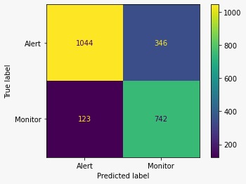
Support vector machine classifier

Slide 14
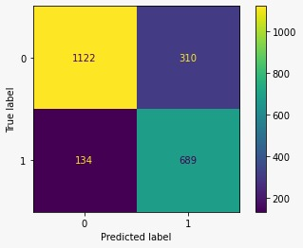
Xg boost

Slide 15
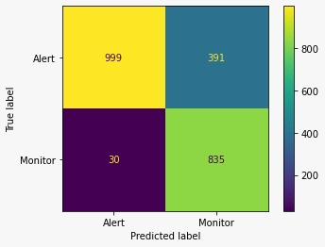
Random Forest

Slide 16
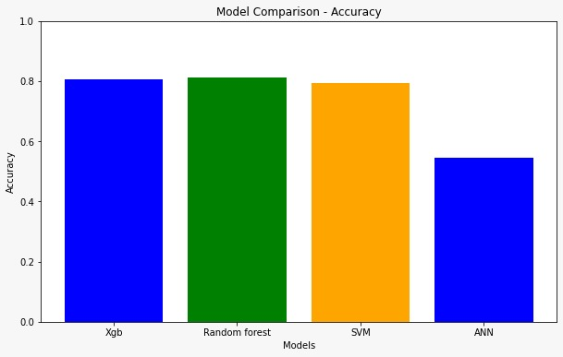
80.31
81.33
79.20
57.54

Slide 17
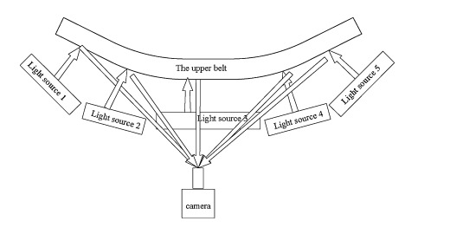
Why CCD?
Image Quality
Low Light Performance
Global Shutter
High-Speed Imaging
Stability and Reliability
Specialized Sensors

Slide 18
Location of Camera
The ROSI project (Robotic Device for the Inspection of Conveyor Belt Rollers
Multiple pulley inspection using a movable camera along a shaft.
Usage of Automated drones with fixed route

Slide 19
Accuracy using camera
Convolutional neural network (Dense net) given 88.16% accuracy for crack prediction of pulley conveyor belt.
Convolutional neural network (Dense net) given 97.5.16% accuracy for foreign residue between the pulley and belt.

Slide 20
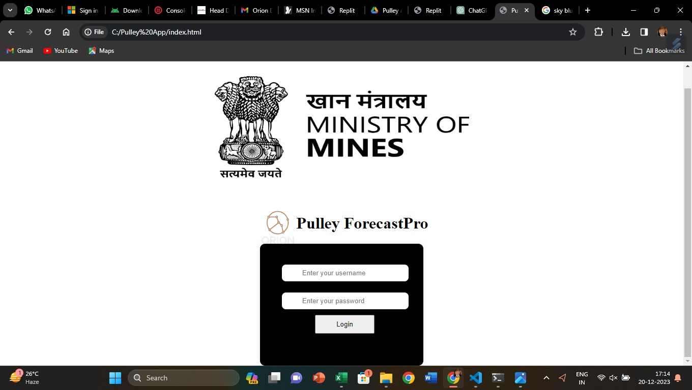
Login Page

Slide 21
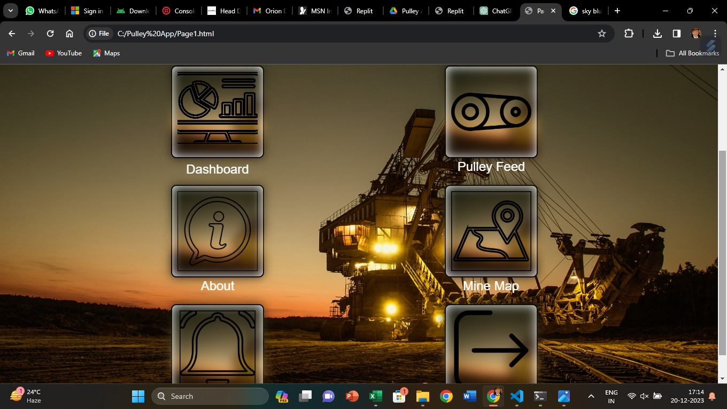
Home Page Screenshot

Slide 22
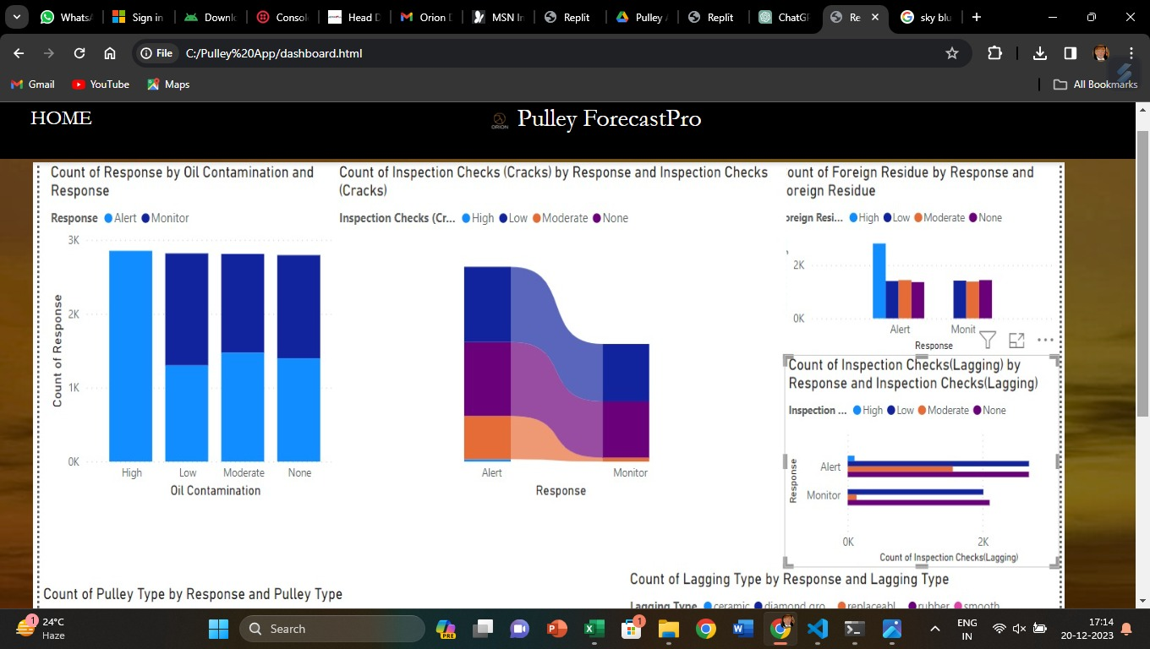
Dashboard Page

Slide 23
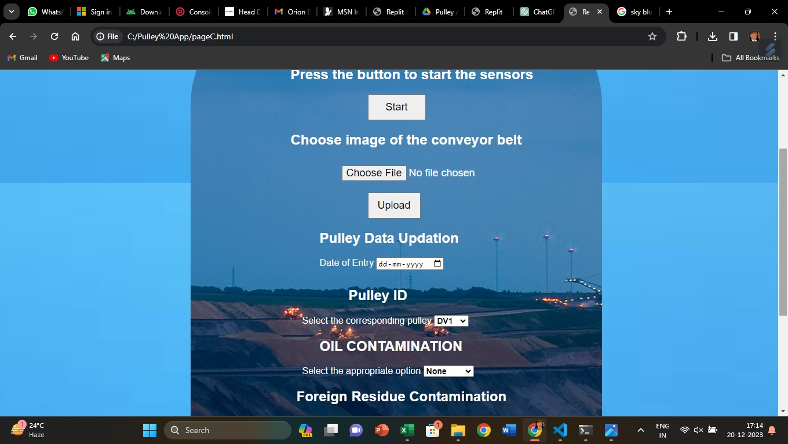
Pulley feed

Slide 24
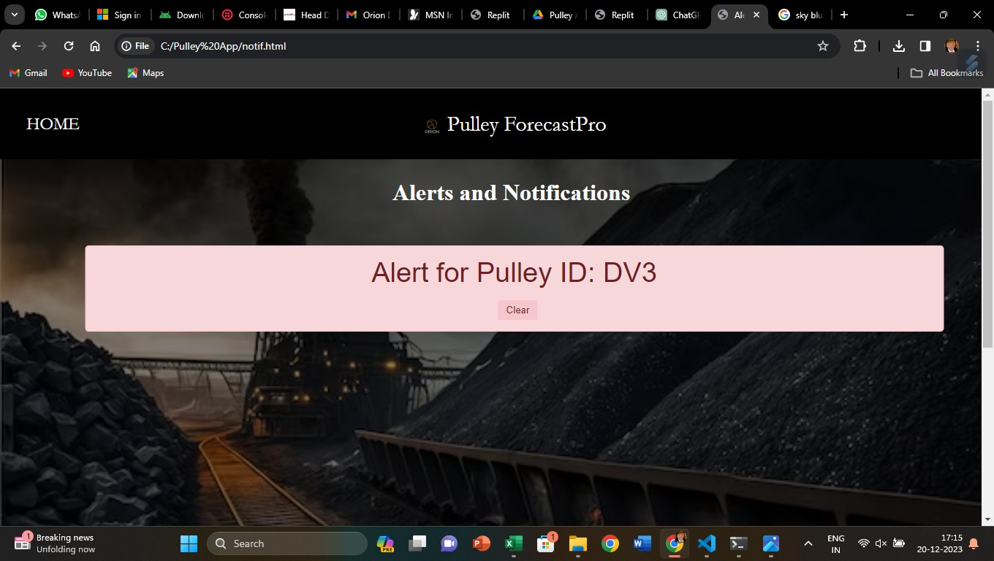
Alerts and Notifications

Slide 25
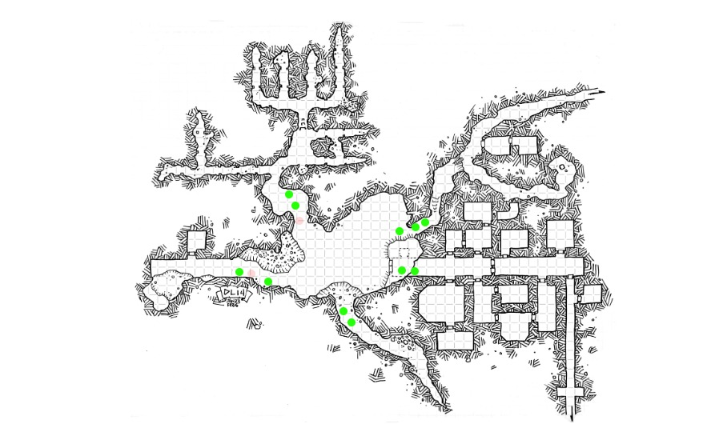
2D Map of pulley location

Slide 26
Team Member Details
Team Leader Name: J Ryan Roy
Team Member 1 Name: A P Subbaiah
Team Member 2 Name: Achintya K
Team Member 3 Name: Tanisha Kulshreshtha
Team Member 4 Name: Prajwal S
Team Member 5 Name: Allen Joe
Team Mentor 1 Name: Dr. Sivakannan S
Thank You

